Slide 1
A Primer on Functional Programming
Sarah Withee

Slide 2


Slide 3
KC People:
What is your favorite experience at KCDC?
Other cities:
What’s your favorite KC experience so far?

Slide 4
A Primer on Functional Programming
Sarah Withee

Slide 5
Monads
(jk)

Slide 6
Poll
Who has heard of functional programming?

Slide 7
Poll
Who has done functional programming?

Slide 8
Poll
Who IS a functional programmer?

Slide 9
Poll
Who has wanted to learn but never had time or good resources?

Slide 10
Intro
Functional Programming Concepts
Examples
Why Use Functional Programming?
Look at Programming Languages

Slide 11
Background
It’s not new
(Languages and ideas been around since the 1950s)

Slide 12
Background
Built on ideas of lambda calculus
developed in the 1930s
(I promise, I won’t cover this today)

Slide 13
Concepts – Pure Functions
Pure Functions:
Function that, given a certain input, always produces the same output.

Slide 14
Concepts – Pure Functions
Pure functions don’t have side effects

Slide 15
Concepts – Pure Functions
Side effects include:
Time, file access, database access, previous function calls, etc.

Slide 16
Concepts – Pure Functions
User input is never pure (duh)

Slide 17
Concepts – Pure Functions
Call by reference is never pure

Slide 18
Concepts – Pure Functions
Nearly impossible to write 100% pure function programs

Slide 19
Concepts – Pure Functions
Examples:
sin(x)
Returns the sine of angle x

Slide 20
Concepts – Pure Functions
Examples:
str.length()
Returns the length of the string str

Slide 21
Concepts – Pure Functions
Examples:
getAccountNumberFromDb(name)
… kidding… definitely not pure

Slide 22
Concepts – Pure Functions
Pure functions, when given certain input, always produce certain output
Pure functions don’t have side effects
User input is never pure (duh)
Call by reference is never pure
Nearly impossible to write 100% of a project in pure functions

Slide 23
Concepts - Referential Transparency
Referential transparency:
Any expression that can replace a function with its return value with no behavior changes

Slide 24
Concepts - Referential Transparency
Example:
If x = 3…
x + 5 = 8 3 + 5 = 8

Slide 25
Concepts - Referential Transparency
In mathematics, all functions are transparent
In programming, this is NOT the case

Slide 26
Concepts - Referential Transparency
Pure functions always have referential transparency

Slide 27
Concepts - Referential Transparency
Assignments are NOT transparent x = x + 1

Slide 28
Concepts - Referential Transparency
def addOne(int x): return x + 1;
If x and y are the same, then
addOne(x) == addOne(y)

Slide 29
Concepts - Lambda functions
Lambda function:
A function without a name
(Also called an anonymous function)

Slide 30
Concepts - Lambda functions
Usually for higher level functions or to pass arguments to one
Usually used once to a few times

Slide 31
Concepts - Lambda functions
Can’t be recursive*
* otherwise they need a name or some way of maintaining state**
** which is possible but outside of this scope

Slide 32
Concepts - Lambda functions
Example:
f = lambda x: x*x
print f(5)

Slide 33
Concepts - Lambda functions
Functions ARE values
Functions can be passed as values into functions

Slide 34
(Warning: mind blowing example ahead)

Slide 35
Concepts - Lambda functions
def divide(x, y): return x/y
def divisor(d): return lambda r: divide (r, d)
half = divisor(2)
print half(32)
lambda r: divide(r, 2)
divide(32, 2)

Slide 36
Concepts - Extra
Monads
Closures
Functors
Outside of the scope of today

Slide 37
Why Use Functional Languages?
Pure functions are simpler and faster to write

Slide 38
Why Use Functional Languages?
Pure functions that work correctly will always work correctly

Slide 39
Why Use Functional Languages?
Stack traces are a pain in OOP
Stack traces in FP simplify things

Slide 40
Why Use Functional Languages?
No side effects makes unit tests pass reliably

Slide 41
Why Use Functional Languages?
Global state of program isn’t affected by pure functions

Slide 42
Why Use Functional Languages?
Concurrency is WAY easier

Slide 43
Why Use Functional Languages?
Code ends up better as functions are designed better
Better small modules -> better large modules

Slide 44
Why Use Functional Languages?
Pure functions are simpler and faster to write
Pure functions that work correctly will always work correctly
Stack traces in FP simplify things
No side effects makes unit tests pass reliably
Global state of program isn’t affected by pure functions
Concurrency is WAY easier
Functions are designed better
Better small modules -> better large modules

Slide 45
Activity 1
In a moment, everyone will stand up.
Start at the beginning of the room with 0
Take the previous number, add 1 to it
Say the number
Sit down
Last person reports the total

Slide 46
Activity 2
In a moment, everyone will stand up.
Find a neighbor
Take their total and add 1
Neighbor sits down
Return your result to person next to you
You sit down
Extra volunteer will count the array of results (end of each row), add them up
Volunteer will return the final result

Slide 47
Example of Functional Thinking
Activity 1 resembles a for or while loop
x = x + 1 type thought
Took a long time
n steps

Slide 48
Example of Functional Thinking
Activity 2 resembles concurrent recursive function
def countPerson (theirNum): return theirNum + 1 def rows (arrayValues): return sum(arrayValues) + 1
Multiple sets counted at the same time
Much faster and fewer steps

Slide 49
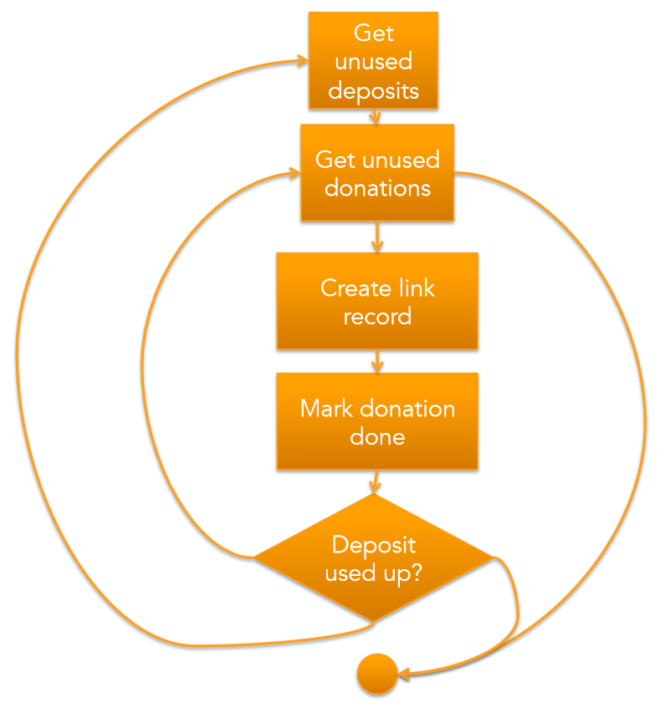
Curtesy of Jessica Kerr (@jessitron)

Slide 50
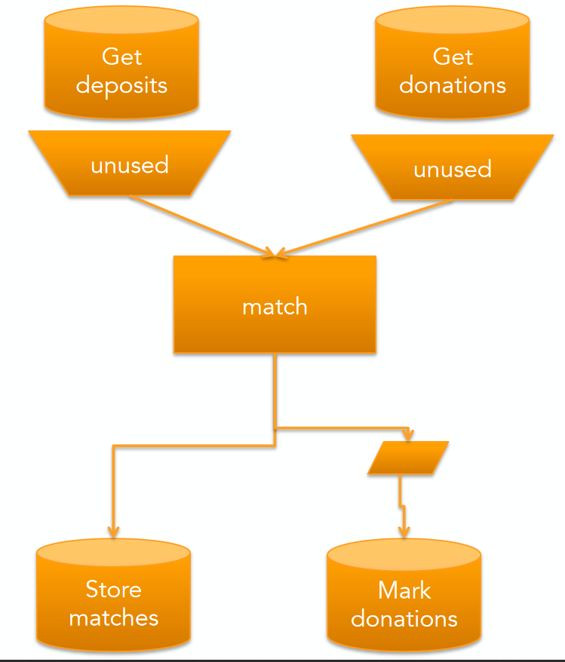
Curtesy of Jessica Kerr (@jessitron)

Slide 51
List of Functional Languages (Pure)
Agda
Charity
Clean
Coq
Curry
Elm
Frege
Haskell
Hope
Joy
Mercury
Miranda
Idris
SequenceL

Slide 52
List of Functional Languages (Not Pure)
APL
ATS
CAL
C++ (since C++11)
C#
Ceylon
D
Dart
ECMAScript
ActionScript
ECMAScript for XML
JavaScript
Jscript
Erlang
Elixir
LFE
F#
FPr
Groovy
Hop
J
Java (since Java 8)
Julia
Lisp
Clojure
Common Lisp
Dylan
Emacs Lisp
LFE
Little b
Logo
Scheme
Racket
Tea
Mathematica
ML
Standard ML
Alice
Ocaml
Nemerle
Opal
OPS5
Poplog
Python
Q
R
Ruby
REFAL
Rust
Scala
Spreadsheets

Slide 53
Languages - Elm
Pure functional language
Statically typed (primitive types, lists, tuples, records, unions)
Immutable types (keeps data pure by making you create new variables)
No runtime exceptions (compiler finds them first)
Super friendly error messages
Compiles to JavaScript for the browser

Slide 54
Languages - Haskell
Pure functional language
Statically typed, type inference
Lazy evaluation and pattern matching

Slide 55
Languages - LISP
“LISt Processor”
(Known as the language with all the parentheses)
NOT a pure functional language
Dynamically typed (mostly lists of any type)
Solve on first item in list, recursively solve on rest of list

Slide 56
Languages - Clojure
Dialect of LISP
Dynamically typed
Runs on Java Virtual Machine (JVM)
Used by Amazon, Capital One, Cerner, Groupon, Spotify, many others

Slide 57
Languages – F#
Functional and Object Oriented (compiles into .Net)
Based on Ocaml and C#
Strongly typed, but inferred
Every statement returns a type
Parallelism is easily built into language
Great for data analysis

Slide 58
Languages – Scala
Runs on JVM, can use Java libraries/code
Object-oriented (like Java) but functional too
Statically typed
Lazy evaluation
Immutable types

Slide 59
Conclusion
Functional programming is getting popular, but been around for decades
Functional principles makes your code simpler, smaller, and more reliable
There’s many functional languages so you can find one that’s similar to your favorite language

Slide 60
Thank You!
Sarah Withee
@geekygirlsarah
sarah@sarahwithee.com
I’d love to hear how you’re using your new knowledge!

